Slide 1
Universal Microelectronics Co., Ltd.
環隆科技股份有限公司
(股票代號：2413)
法人說明會
2018年11月23日

Slide 2
AGENDA
1
Company Profile
2
Product Development
3
Marketing
4
Future Vision

Slide 3
AGENDA
1
Company Profile

Slide 4
Company Profile
INITIAL OPERATION
» January 1984
EMPLOYEES :
» Taiwan — 650
» China — 4000
» Vietnam - 1000
Headquarters Taichung Taiwan
Taichung Factory
CAPITAL :
» US$ 43,209,000
INITIAL PUBLIC OFFERINGS:
» October 1998
ANNUAL SALES:
» US$ 106,244,432.17(2018 Q1-Q3)
Shenzhen Factory
Meizhou Factory
PLANT FLOOR AREA :
» 32,100 m² ---- Taiwan HQ and Factory
» 72,200 m² ---- Shenzhen Factory
» 9,200 m² ---- Longyan Factory
» 7,200 m² ---- Meizhou Factory
» 13,000 m² ---- Hanoi Factory
Hanoi Factory
Longyan Factory

Slide 5
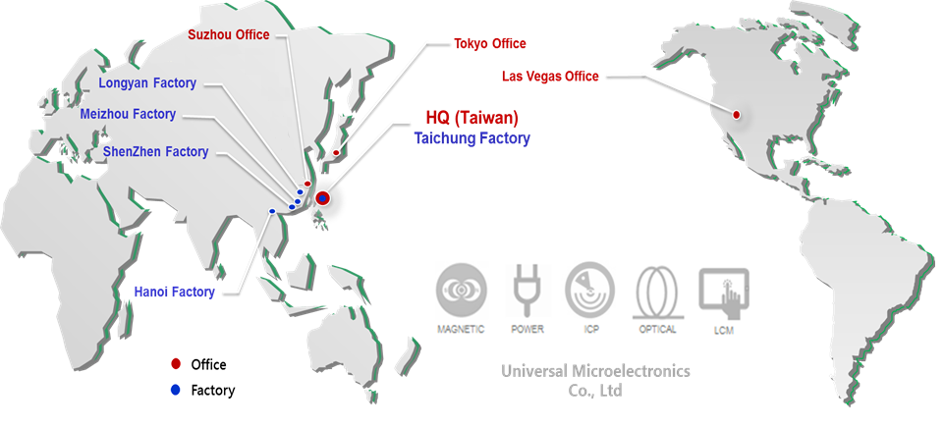
Global Office & Sites

Slide 6
AGENDA
2
Product Development

Slide 7
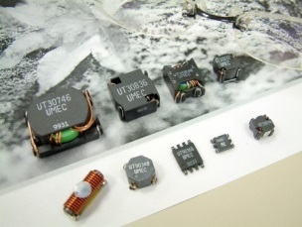
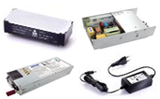
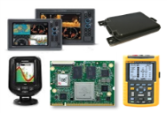
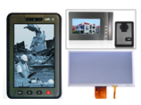
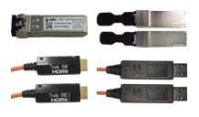
Product Segmentation
Universal Microelectronics Co., Ltd
UMEC
MAGNETIC
POWER
ICP
LCM
OPTICAL
* RF transformer
* Telecommunications
* Power Transformer
* Inductor Products
* Custom Design
Transformer/ Inductor
* DC/DC Converters
* AC Open Frame
* Power Adapter
* Hot-swappable
Redundant Power
DMS/ EMS
* Marine & GPS Product
* Automotive Radar
* Wearable Device
* BLE related Consumer
* 3.5inch ~ 19inch
* COG, FOG, POG
* Lamination, OCR
* Film on Sensor Glass
* LCM assembly
* Ultra High Speed AOC :
HDMI, DVI, USB3.0,
SFP+, QSFP+
* Passive Components:
CWDM/ DWDM
Fused Biconical Taper

Slide 8
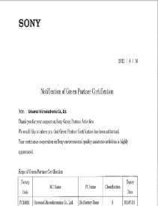
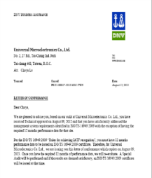
Certification
CERTIFICATIONS:
Taiwan Factory — ISO 9001
— ISO 14001
— ISO/TS 16949
— ISO 13485
— TL 9000
— UL / TUV
— SONY GP
— MFi Manufacturing
China Factory — ISO 9001
— ISO 14001
— ISO/TS 16949
— UL / TUV
— QC 080000
— SONY SPP
— OHSAS 18001
— MFi Manufacturing
Vietnam Factory — ISO 9001
— UL / TUV
— ISO 14001
— MFi Manufacturing

Slide 9
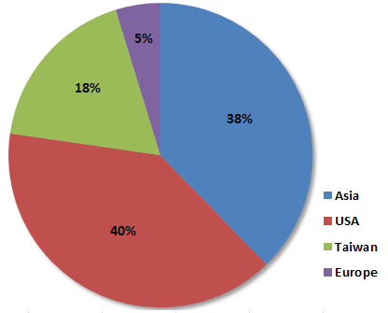
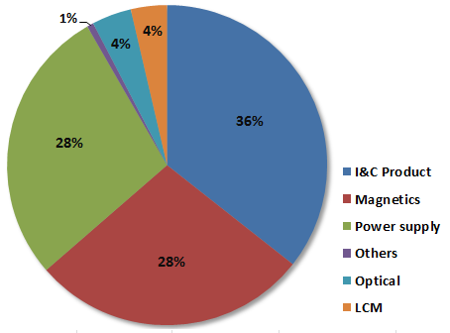
2017 Sales Revenue Update
2017 ANNUAL SALES: US$121,821,970.
● By Territory
● By Product Line

Slide 10
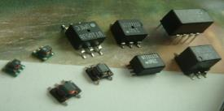
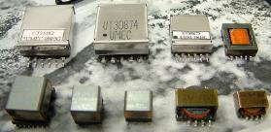
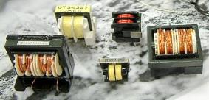
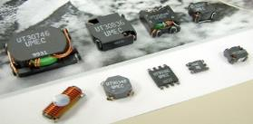
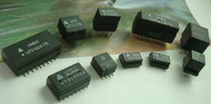
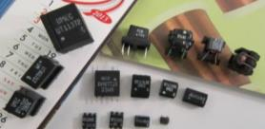
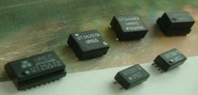
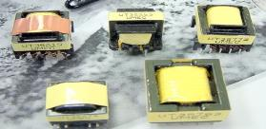
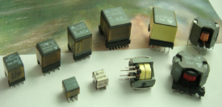
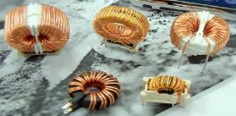
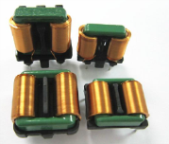
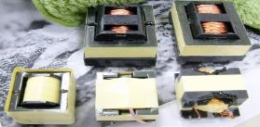
Magnetic Component Product
Total Capacity: 20KKpcs/ month
RF Baluns/Transformers
SMD Transformer
Common Mode Choke
SMD Inductor
ISDN S/U-interface Transformers
Data Coupling
Transformers
Common Mode Chock for ADSL/VDSL
Transformer for Power Applications
XDSL Transformers/POTS Inductors
Transformer & Inductor by Ringing Core Design
Flat Wire
Common Mode Choke
Transformer

Slide 11
Magnetic Component Product
IC Manufacturer | Technical
ADI | HomePlug/VDSL2
Broadcom | ADSL/ADSL2+/VDSL2/ADSL2+/ VDSL3/G.FAST HomePlug/VDSL/VDSL2
Broadcom(Gigle) | HomePlug
Ikanos(Globespan) | ADSL/ADSL2+/G.SHDSL/VDSL
Ikanos(Globespan,Conexant) | ADSL2+/G.SHDSL/VDSL/VDSL2
Lantiq | Power
Intel ( Lantiq, Infineon) | ADSL/ADSL2+/MDSL/SDSL /VDSL/VDSL2/G.FAST
Level One | DDS
Marvell (DS2) | G.hn/HomePlug
MicroSemi (Zarlink, Legerity) | ADSL/ADSL2+/POTS
Mstar, Qualcomm(Atheros,Intellon), Silicon Labs | HomePlug
Realtek, Metanoia, Sckipio | G.FAST/VDSL2
Sigma Designs (CopperGate) | G.hn/HomePlug/HPNA3
Silicon Labs | VoIP (Power)
Texas Instruments, STM | Power
Teridian | Analog
Triductor, INTEL(Lantiq), Metanoia | VDSL2
Total Capacity : 20kkpcs per month.
Telecom Transformers/Inductors : 9kkpcs per month
(Ferrite EE5, EP7, EP10, EPX10, EP13, EPC13, RM4, RM5, RM6, TKH7---)
LAN, ISDN, T1/E1, T3/E3 Transformers/Inductors : 3kkpcs/ per month
(Ferrite Ring core T2.5~T10 ----)
Power Transformers/Inductors : 8kkpcs per month
(Ferrite EF16~EF32/11, EE40,-------)

Slide 12
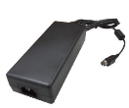
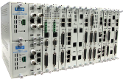
Power Supply Product
DC/DC Brick
For Telecom / Datacom & Industrial Control System
AC / DC Adapter
For Datacom System
Encapsulated 1/2, 1/4, 1/8 and 1/16 Brick series are available from 50W to 350W.
Adapters are available with power range from 3W to 160W.
DC/DC Cu Case
For Telecom / Datacom & Industrial Control System
AC / DC Open Frame
For Color Laser Printer, Multifunction Printer
Industrial DC/DC Module series are available from 6W to 60W.
I.T.E Power Supply are available with power range from 5W to 880W.
DC/DC Multilayer Converter
For Telecom / Datacom and Industrial Control System
Redundant(CRPS)
For Networking System
Hi Density DC/DC Board Mount Modules are available from 50W to 420W.
Redundant PoE Switch Application with range: from 250W to 2000W.

Slide 13
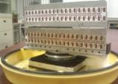
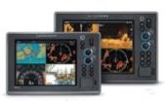
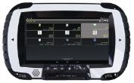
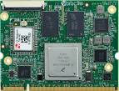
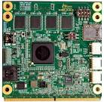
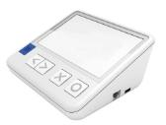
Information & Communication Product
DMS/ EMS
Marine Products
GPS System
Radar
Fish Finder, Transducer
Marine Chart Plotter
Trolling Motor Control System
Solid State Marine Radar
Automotive Products
Automotive FMCW Radar
Car Multimedia System
Power Lift Gate module
Consumer Products
Wearable & IOT Devices
Controlling Center Platform & System in
ZigBee/ Wi-Fi/BT
Industrial Android Rugged Tablet Solution

Slide 14
Automotive Radar Solution
RTCA
DOW
BSD/LCA
RCW
FCW
FCTA
Camera Solution
BACKUP AID
DOW
BSD/LCA
RTCA
79G SRR Function
Blind Spot Detection
Lane Change Assistance
Door Open Warning
Rear Cross Traffic Alert
Rear Collision Warning
Backup Aid
77G MRR Sensor-Fusion
Front Cross Traffic Alert
Forward Collision Warning

Slide 15
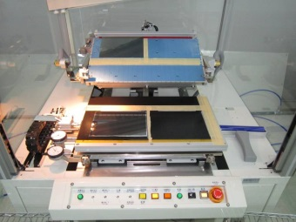
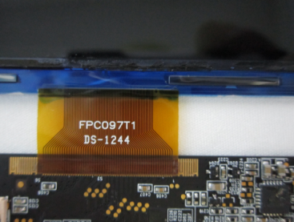
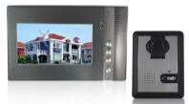
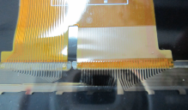
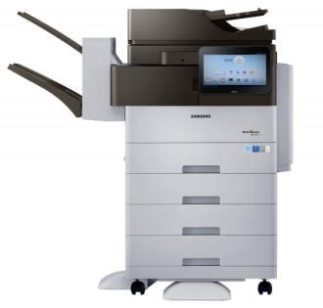
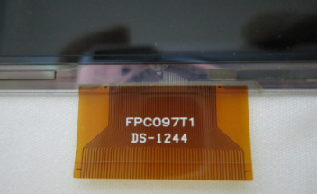
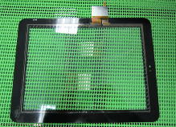
LCM Process & Product
Polarize on Glass
Film On Board
Chip On Glass
Film On Sensor Glass
FPC On Glass
Lamination(OCR)

Slide 16
Optical Communication
Ultra High Speed AOC :
HDMI, DVI, USB3.0, SFP+, QSFP+
Component:
CWDM/DWDM
Fused Biconical Taper（FBT)
Target Application:
Medical Imaging Equipment
Cloud Computing
Telecommunications
Conference Room Video System
Factory Automation Systems
LED signboards and Kiosk.
USB3.0 AOC
(5Gbps)
8CH Compact CWDM
SFP+ Transceiver
(10Gbps)
QSFP+ Transceiver
(40Gbps)

Slide 17
AGENDA
3
Marketing

Slide 18
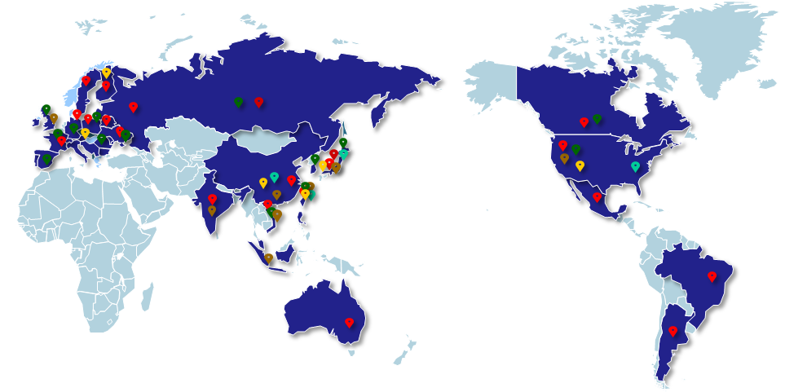
Marketing
MAGNETIC
POWER
ICP(EMS/ODM)
OPTICAL
LCM
SWEDEN
Finland
Germany
Russia
Belgium
Canada
UK
Belarus
France
Bulgaria
Italy
Japan
USA
SPAIN
Israel
China
Korean
India
Taiwan
Mexico
Vietnam
Singapore
Brazil
Australia
Argentina

Slide 19
AGENDA
4
Future Vision

Slide 20
Future Vision
G.Fast, Redundent Power Supply
Marine and Automotive Radar Solution
Wearable Device
100G DWDM
Ultra High Speed AOC, USB3.1

Slide 21
Thanks for Your Attention!

